Slide 1

Information and Network Security(INS)

Slide 2
INS - Lecture 7,8 and 9 Presented by: Drashti Shrimal

Slide 3
UNIT 1: Topics in this presentation
- Encryption Basics
- Types of Encryption
- Symmetric Encryption Model
- Types of Symmetric Encryption

Slide 4
Basics before Encryption techniques
Cryptography:
The art and science of concealing the messages to introduce secrecy in information security is recognized as cryptography.
The word ‘cryptography’ was coined by combining two Greek words, ‘Krypto’ meaning hidden and ‘graphene’ meaning writing.

Slide 5
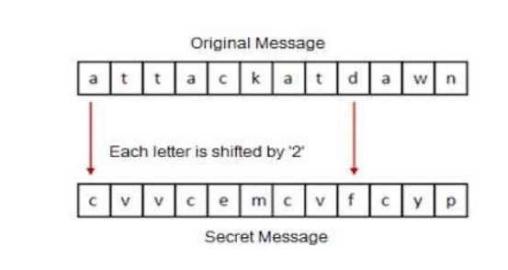
Basics before Encryption techniques
Shift Cipher: Done by shifting the letters of a message by an agreed number, the recipient of this message would then shift the letters back by the same number and obtain the original message.

Slide 6
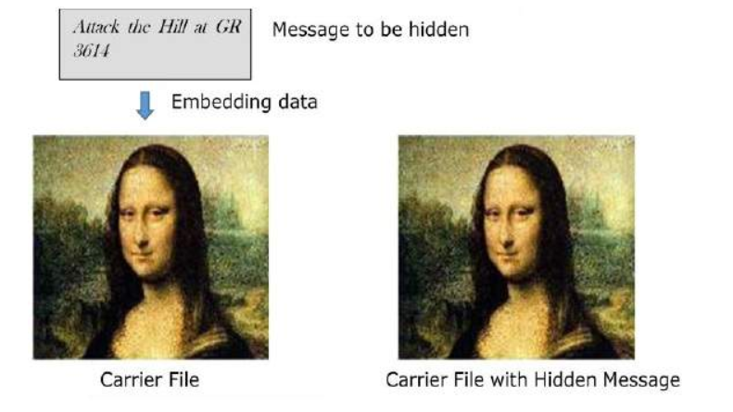
Interesting Fact
Steganography
Steganography is similar but adds another dimension to Cryptography. In this method, people not only want to protect the secrecy of an information by concealing it, but they also want to make sure any unauthorized person gets no evidence that the information even exists. For example, invisible watermarking.

Slide 7
Encyption Basics
1. Plaintext: The original message without any encryption techniques.
2. Encryption Algorithm: Technique used to convert plaintext to encrypted text.
3. (Secret)Key: The input for the encryption algorithm.
4. Cipher Text: Output of encryption algorithm.
5. Decryption Algorithm: The encryption algo to be run in reverse.

Slide 8
Types of Encryption
Symmetric:
Same key used to encrypt and decrypt.
Assymetric:
Different key used to encrypt and decrypt.

Slide 9
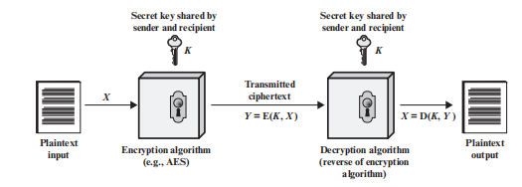
Symmetric Cipher Model

Slide 10
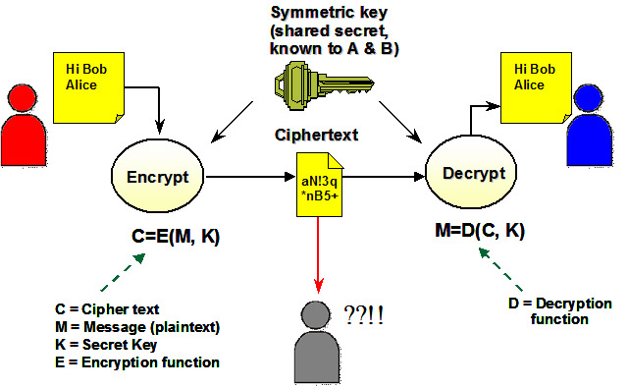
The Alice and Bob example

Slide 11
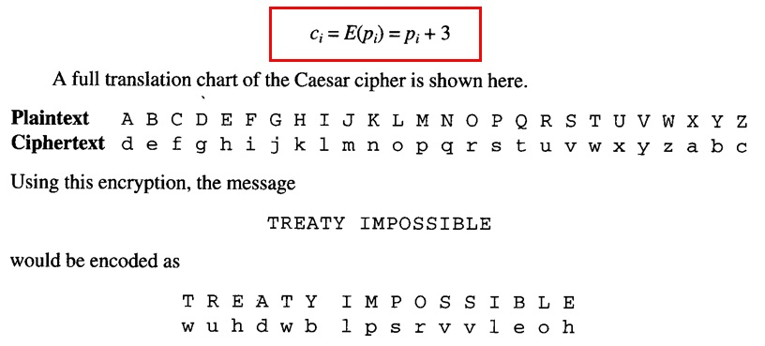
Let's learn an example

Slide 12
Types of Symmetric Encryption
Substitution - Ex:
Plaintext : ABC
Ciphertext : XYZ
Transposition - Ex:
Plaintext : ABC
Ciphertext: CAB

Slide 13
Thanks!
Any questions?
You can post your questions on Google Classroom.

